Slide 1


Minor Project
Title:
Statistical Data Visualizer Library
Presented by:
Aryan Kumar ,R214220255, CSE AIML-H
Manika Rajpal;,R214220669, CSE CSF-NH
Palak Singh, R214220794, CSE AIML-H
Sanskar, R2142201027, CSE CSF-NH
Guided by:
Mr.
Assistant Professor (SS)
Systemics Cluster
School of Computer Science

Slide 2
Content
Introduction
Problem Statement
Motivation
Objectives
Tech Stack
Methodology
Implementation
SWOT Analysis
Application of the Project
PERT Chart
Objectives Covered
References

Slide 3
1. Introduction
Ensuring the security of applications getting deployed is a tiresome task.
VMware follows an automated build process called vRelease Code Stream that automatically builds, tests and scans the application and builds a runnable artifact for the application. Whenever build is triggered, the security tools test and scan the application code for any possible risks and vulnerabilities.
The various elements that are inspected closely to find out any existing vulnerabilities and risks present are:-
Source Code (SAST)
Black Box (DAST)
Third Party Libraries (OSS)
Workloads (Containers, Images)

Slide 4
1. Introduction (contd.)
The vulnerabilities found in these scans are stored in a database by various scanning tools managed by DevSecOps team.
A Jira ticket is created for the open vulnerabilities, so that developers can fix the issues found and enhance the security of the application.
This brings on a demand for an application which can organize all the data collected of found vulnerabilities and display it in an analytical way.
The proposed application can help various stakeholders take a risk based decision quickly.

Slide 5
2. Problem Statement
The data collected by all the risk and vulnerability scans is collected into a database and is currently scattered and there is no centralized platform which provides complete view of risks possessed by these vulnerabilities.
There is a need to develop a Unified Vulnerability and Risk Management System (UVRMS) that would aggregate the scattered data and help the stakeholders to manage vulnerabilities and take risk based decision.

Slide 6
3. Motivation
The project aims to have the following features:-
Vulnerability management – All the vulnerabilities present are listed and proper actions can be taken regarding the vulnerabilities using this project.
Triaging – Using the application, triage actions can be performed regarding various vulnerabilities
Risk based decision – The stakeholders can take risk based decisions with the help of graph and statistical data provided by the application.
Secure Deployments – The application ultimately aims to reduce risks and vulnerabilities which ultimately leads to secure deployments.

Slide 7
4. Objectives
To cater the data in an analytical format.
To give a better visual to stakeholders using graphs
To implement vulnerability triage functionality
To develop overall risk home page
To implement SSO (Single Sign On)

Slide 8
5. Technology Stack
Version Control
GitLabs
Development
Backend - Spring Boot , Maven
Frontend - ReactJS , Clarity Design
Java Version - Java 11
Database
DBeaver / MySQL Workbench
Messaging Queue
Rabbit MQ
Deployment
Docker
TKG : VMware product built on
top of Kubernetes architecture
Project Management
Confluence
Jira

Slide 9
6. Methodology
6.1 Development Methodology
The project focuses on building a Unified Vulnerability and Risk Management System using the latest Agile Methodology
6.2 Authorization
Creating a security framework : Integrating with VMware workspace 1 for authentication and authorization so that it adapts Single Sign On(SSO).
6.3 Deployment
Following a complete CI/CD pipeline using Jenkins.
Not focusing on writing Jenkins file because the tool used by VMware implements it by itself.
Create a JAR file of the application, write a dockerfile and create a docker image.
Deployment for kubernetes cluster.

Slide 10
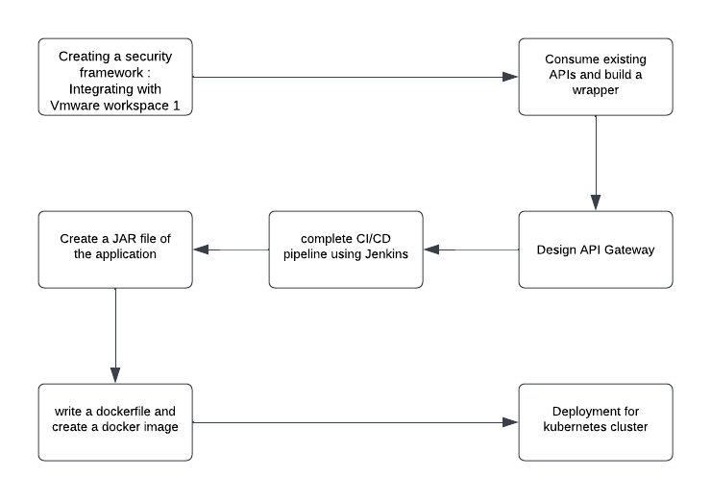
6. Methodology (contd.)
Fig.1 Methodology Chart

Slide 11
6. Methodology (contd.)
6.4 Triaging
The vulnerabilities found in the artifacts that a developer is working on are listed on the developer’s UVRMS portal
Developer can either mark the vulnerabilities as remediated (solve the issue) or mark them a False Positive or Action
Depending on the Triage Action taken by the developer the status is updated and vulnerability is sent to application owner or security team for approval.
The security team makes the final call for triaging a vulnerability.

Slide 12
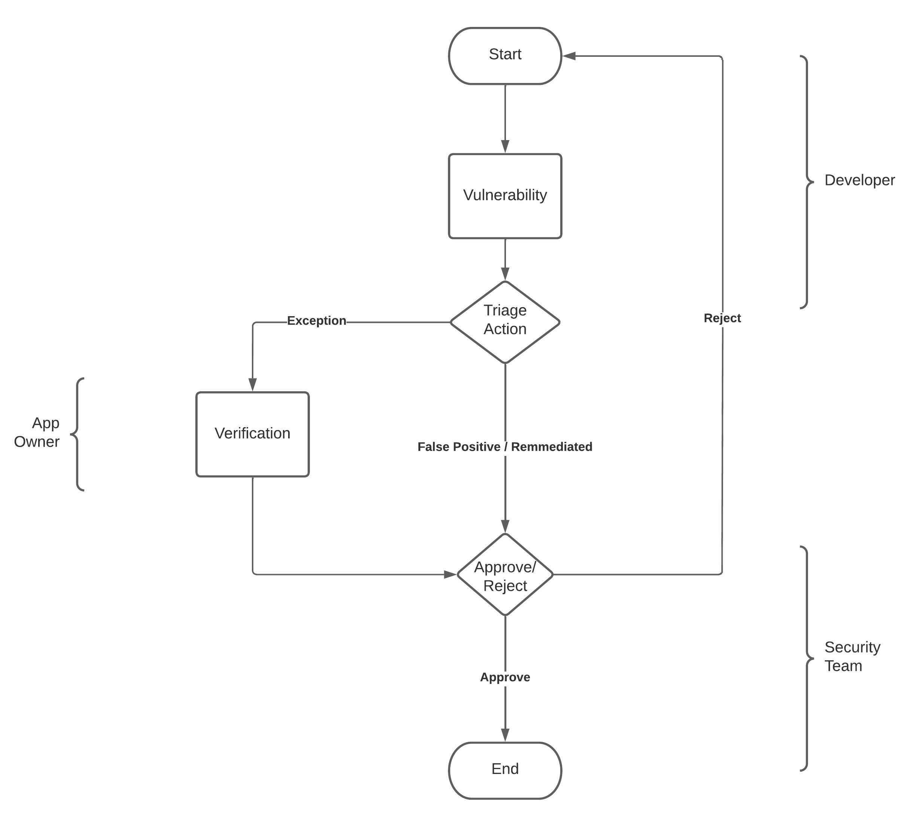
6. Methodology (contd.)
Fig.2 Triaging Workflow

Slide 13
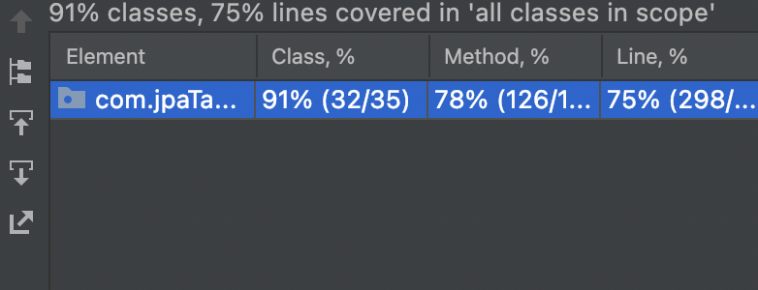
7. Implementation
7.1 Swagger Docs
According to requirement gathering APIs are designed.
Swagger helps to create documentation for APIs so that it becomes easier for the frontend team to consume APIs.
7.2 Test-Driven Development
Using JUnit test cases are written to unit test various APIs
Code Coverage is checked using Jacoco plugin.
Minimum 75% of code should be covered in test cases.
Fig.3 Code Coverage in unit test cases

Slide 14
7. Implementation
7.3 API building
API stubs are created first with dummy data so that the front-end development can progress smoothly.
Later, the actual code for APIs are written and tested.
7.4 Deployment
A JAR file is created for the application and using the JAR file a docker image is generated
Later, the Docker image is deployed to Kubernetes deployment.

Slide 15
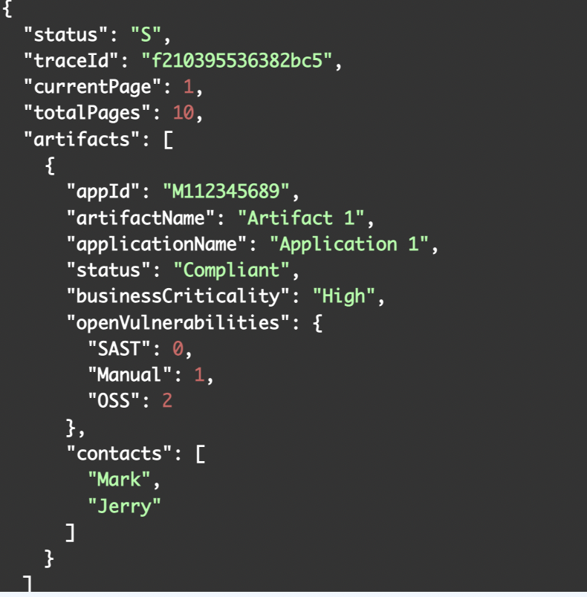
7. Implementation
Fig.4 API success response example

Slide 16
7. Implementation
7.5 RabbitMQ and Email Integration
A queue and an exchange is created which is binded by the routing key in the RMQ config file.
Message is published from the controller to a queue.
Listener code has been implemented in email service which listens to the same queue.
To make the email notification process asynchronous we use rmq to publish message from UVRMS service to the RMQ queue which will then be consumed by the email service that uses JavaMailSender to send email to notifications to the user.
For email service we create a mail config file where the details regarding the host, username, password, etc. for the service are mentioned

Slide 17
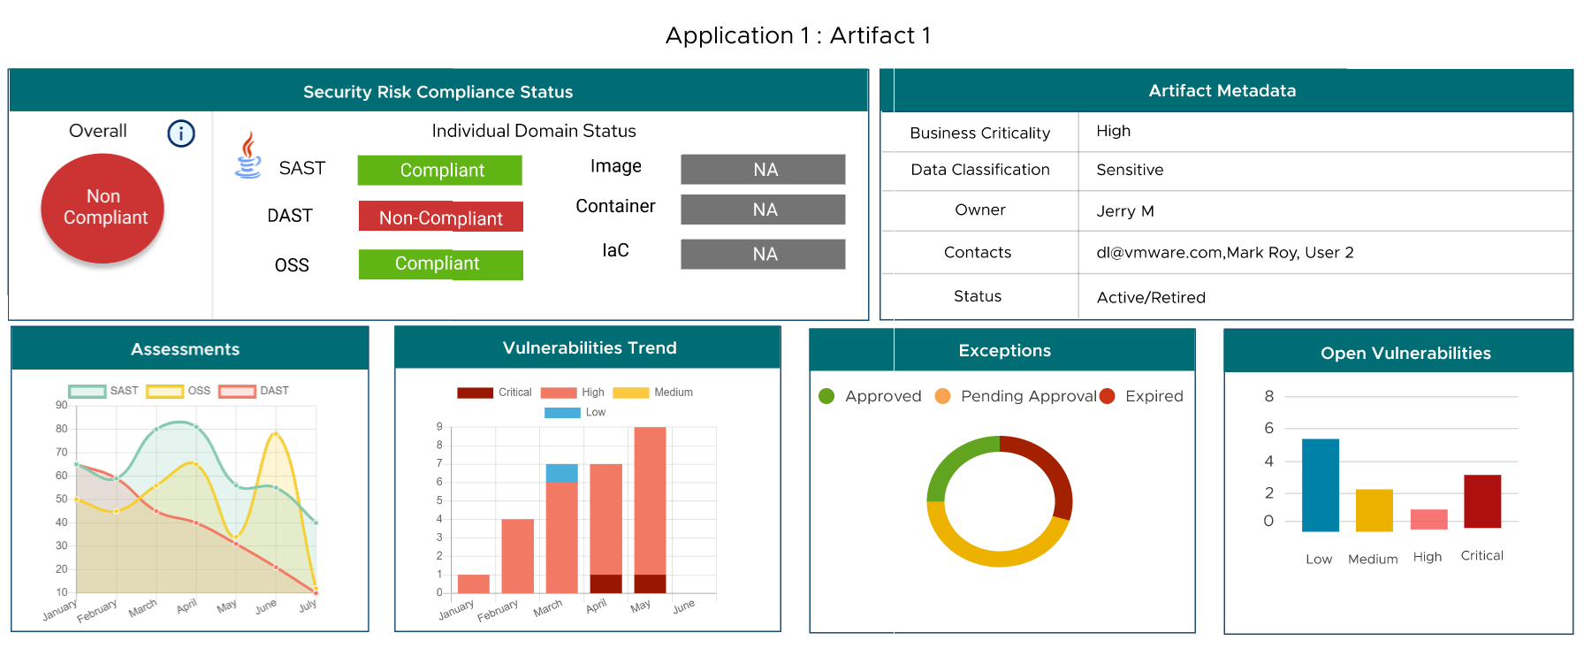
7. Implementation
Fig.5 UVRMS Dashboard

Slide 18
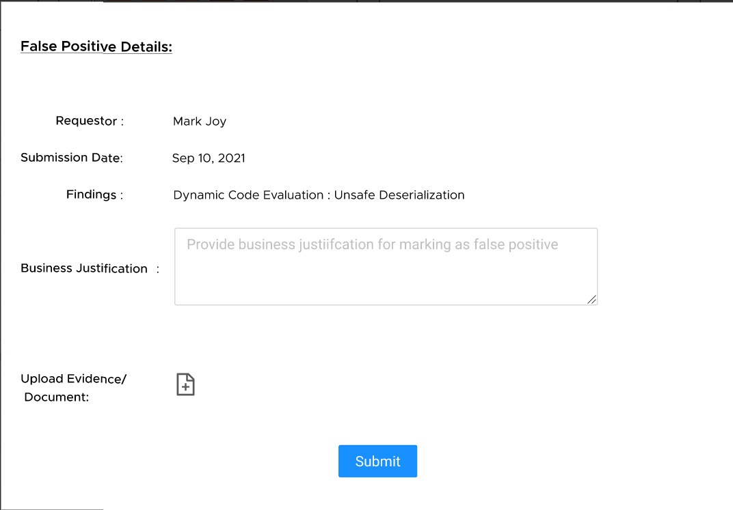
7. Implementation
Fig.5 Triage Action Form

Slide 19
7. SWOT Analysis

Slide 20
8. Application of the Project

Slide 21

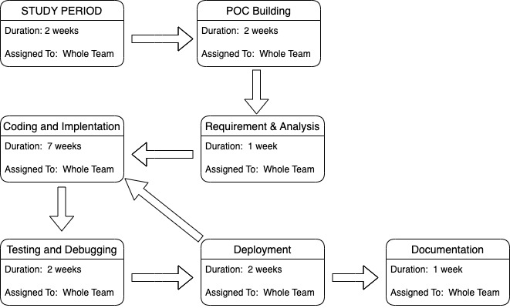
8. PERT Chart
Fig.6 Program Evaluation Review Technique Chart

Slide 22
9. Objectives Covered
Objectives | Status
Learning the technologies used | Completed
Building a POC | Completed
Developing Overall Risk Home | Completed
Implementing Triage workflow | Completed
Develop Artifact Specific Dashboard | Completed

Slide 23
10. References
[1] Y. Li, "A Vulnerability Risk Assessment Method for Industrial Control System," 2020 International Conference on Computer Communication and Network Security (CCNS), 2020, pp. 146-152, doi: 10.1109/CCNS50731.2020.00040.
[2] H. Teymourlouei and V. E. Harris, "Organization Risk Management on Network Vulnerability and Potential Data Breach," 2018 International Conference on Computational Science and Computational Intelligence (CSCI), 2018, pp. 106-111, doi: 10.1109/CSCI46756.2018.00027
[3] https://docs.spring.io/spring-boot/docs/current/reference/htmlsingle/ (accessed on 20/02/2022)
[4] https://swagger.io/docs/specification/about/ (accessed on 20/02/2022)
[5] https://reactjs.org/docs/thinking-in-react.html (accessed on 20/02/2022)
[6] https://app.pluralsight.com/paths/skills/spring-framework-core-spring (accessed on 20/02/2022)
[7] https://www.geeksforgeeks.org/builder-design-pattern/ (accessed on 20/02/2022)
[8] https://vmware.github.io/clarity/documentation/v0.11/get-started (accessed on 20/02/2022)
[9] https://docs.vmware.com/en/VMware-Tanzu-Kubernetes-Grid/index.html (accessed on 20/02/2022)

Slide 24
Thank You

